Slide 1
The math company market mix modeling project

Slide 2
Goal and METHODS
Use some statistical analysis, data visualization and machine learning methods to find out the factors that affect ROI and provide a basis for future business adjustment of expenditure allocation
Python

Slide 3
Dependant Variable
Total_DeseasonalizedMarketplace_Revenue
Total_Marketplace_SeasonalIndex
Total_Total_Visits
RevenueByRetail_Marketplace_Revenue

Slide 4
Independent variable (142)
Autotrader_FranchiseDealers_DealerCount
Autotrader_IndieDealers_DealerCount
Autotrader_New_Inventory
Autotrader_Total_Inventory
Autotrader_TotalDealers_DealerCount
Autotrader_Used_Inventory …………

Slide 5
Basic Data Trend
revenue
competitor
leads visits spends
macro
inventory

Slide 6
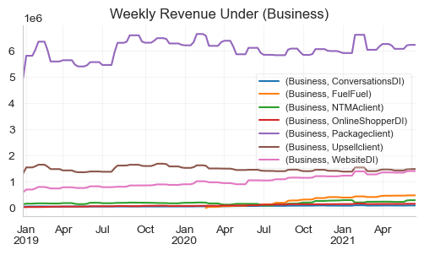
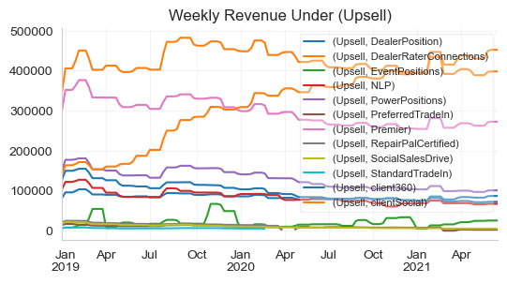
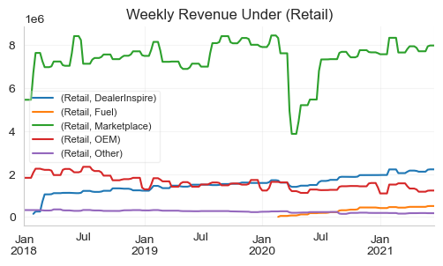
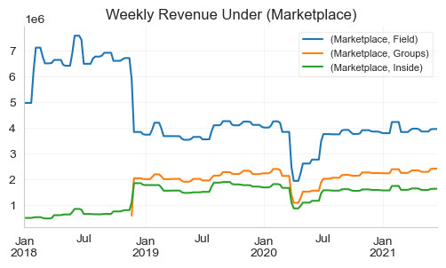
Trend of each category data by week

Slide 7
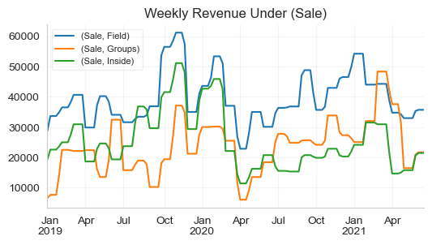
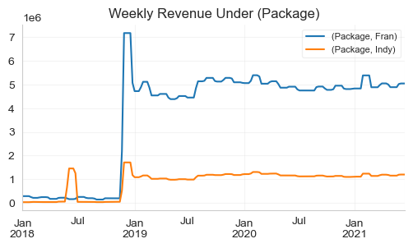
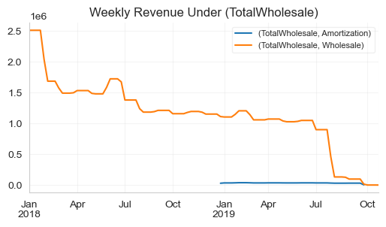
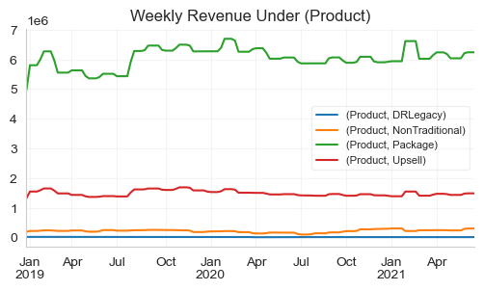
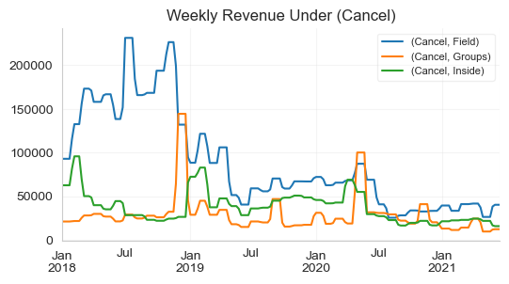

Slide 8
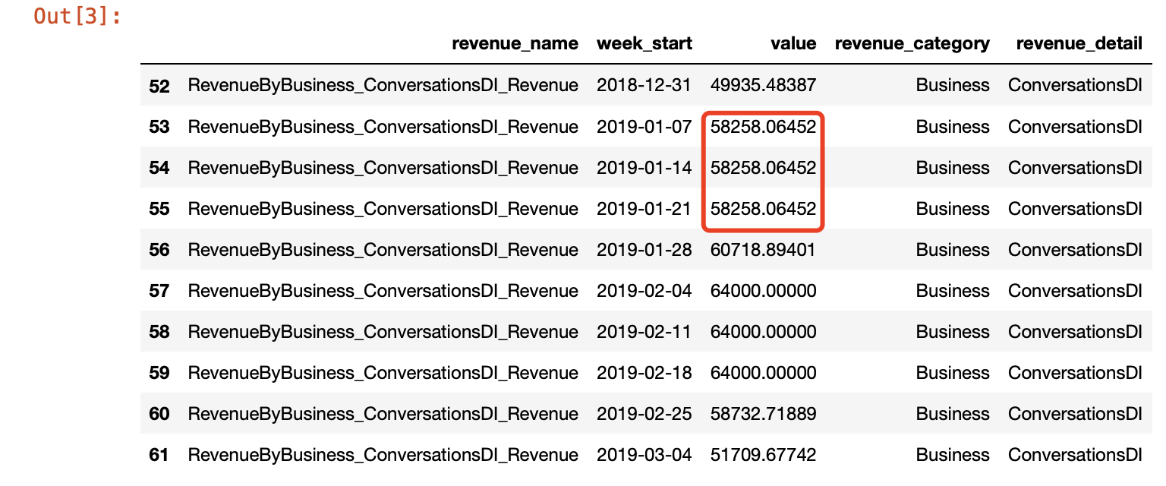

Slide 9
Basic Data Trend
revenue
competitor
leads visits spends
macro
inventory

Slide 10
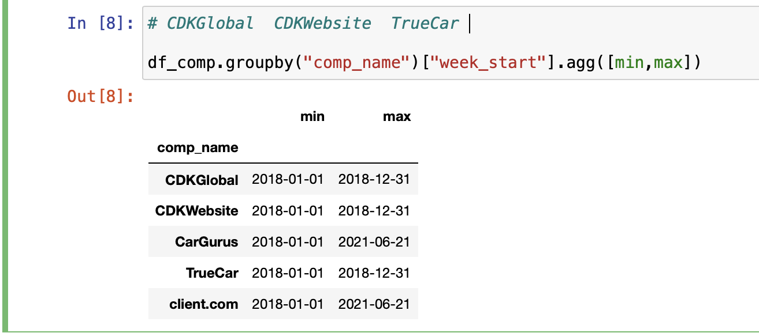
Competitor five competitors and each competitor has four dimensions of weekly data
Five competitors CDKGlobal', 'CDKWebsite’,
'CarGurus', 'client.com', 'TrueCar
Four dimensios CostofRevenue', 'Revenue', 'MarketingandSales', 'OperatingExpense
‘CDKGlobal’, ‘CDKWebsite’ ,’TrueCar’. None of these three competitors have data after 2019-01

Slide 11
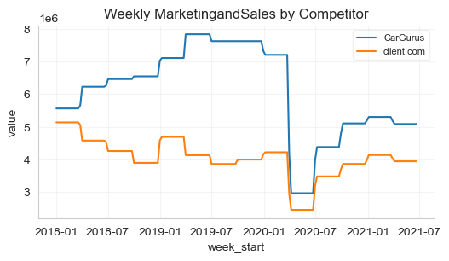
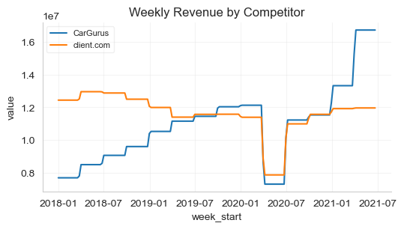
Competitor MarketingandSales and Revenue demensions

Slide 12
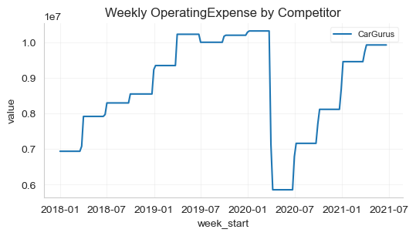
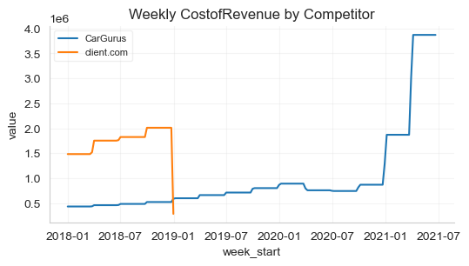
Competitor OperatingExpense and CostofRevenue

Slide 13
Basic Data Trend
revenue
competitor
leads visits spends
macro
inventory

Slide 14
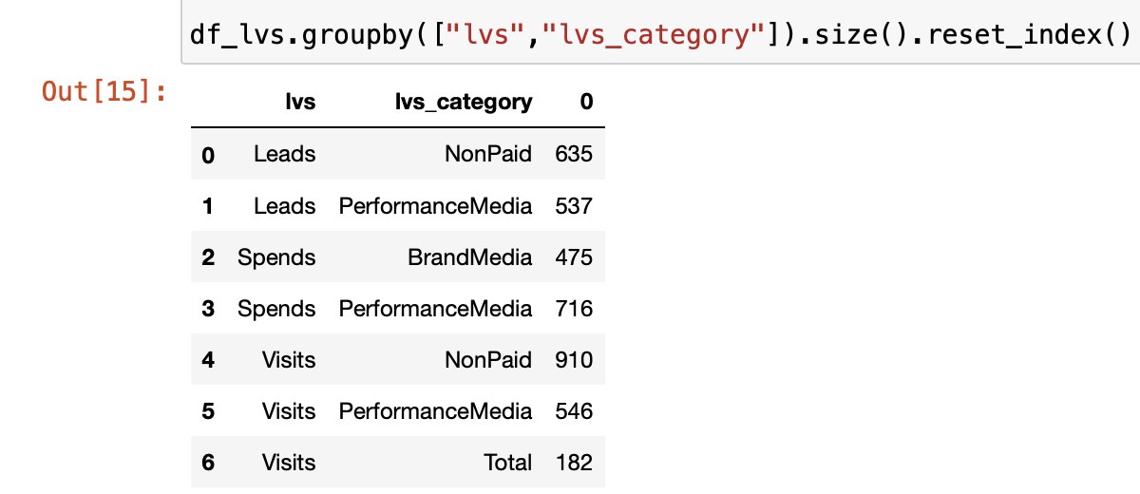
leads, visits, spends

Slide 15

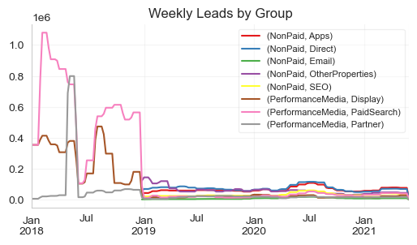
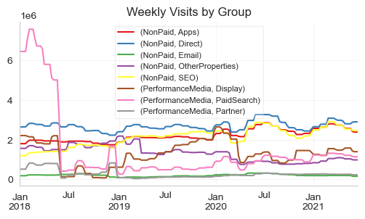
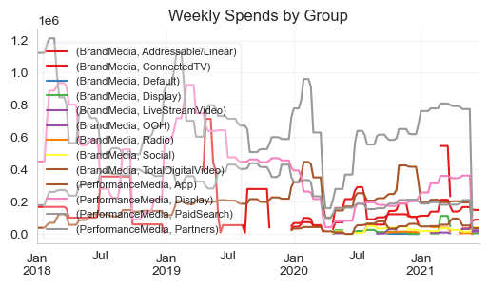
leads, visits, spends
——the trend

Slide 16
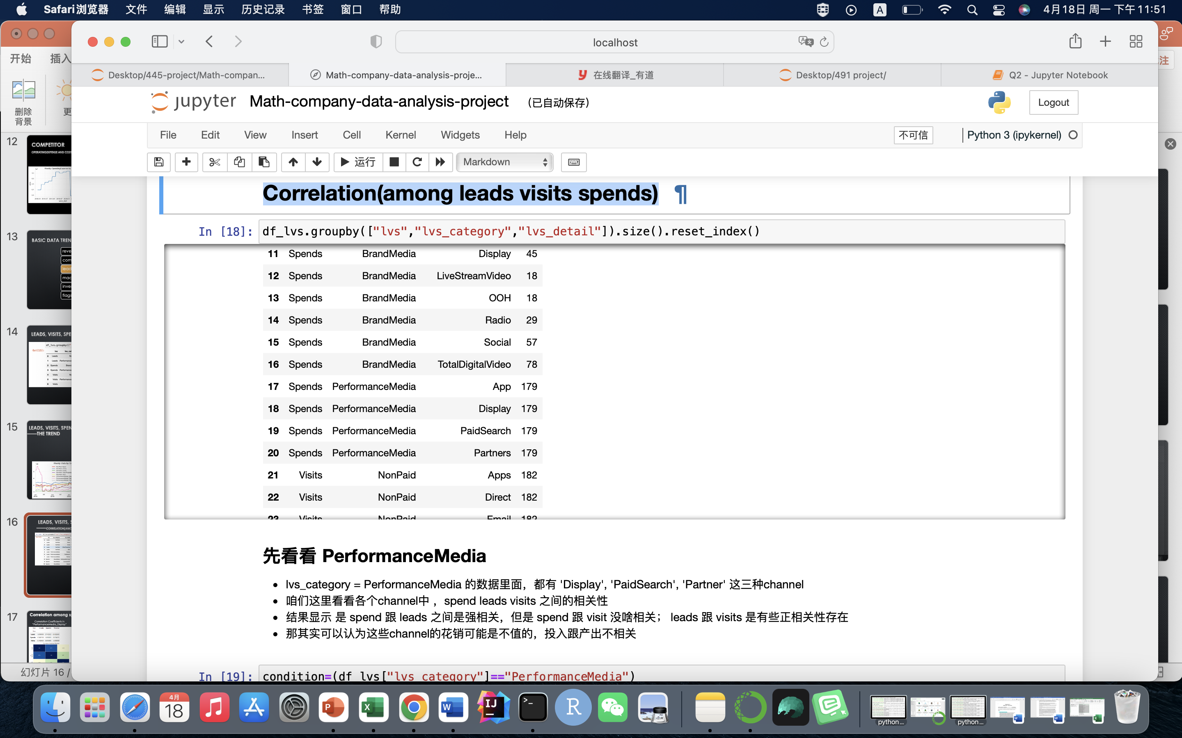
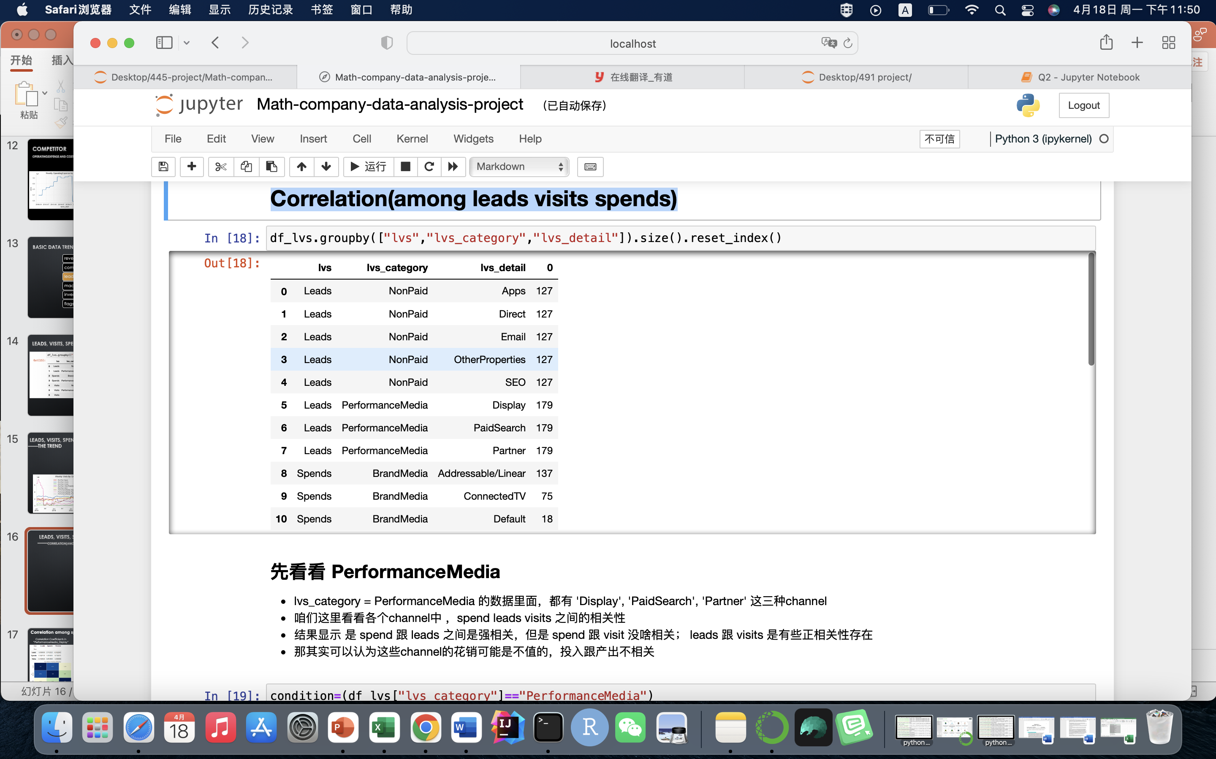
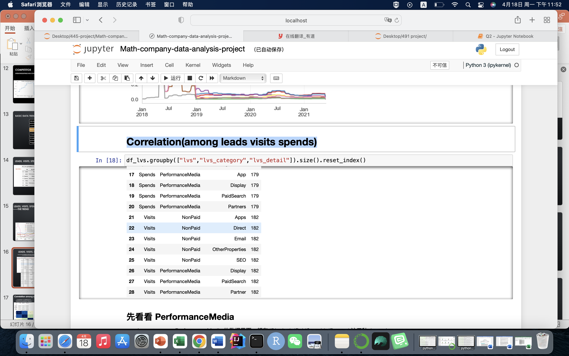
leads, visits, spends
——Correlation(among leads visits spends)

Slide 17
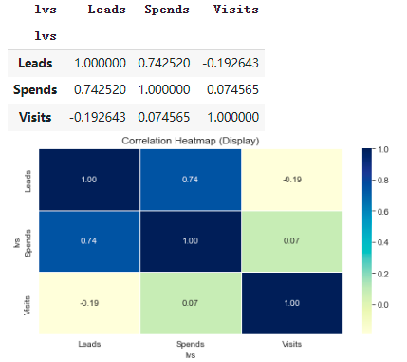
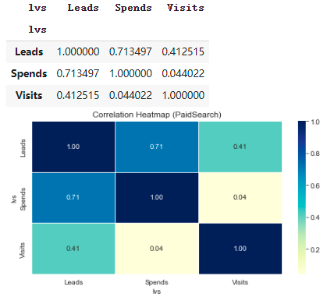
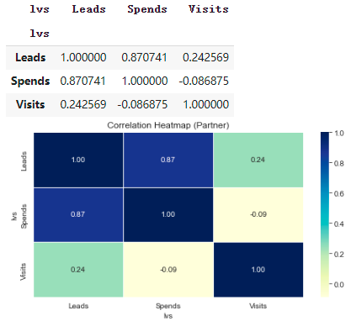
Correlation among spend, leads and visits in Performancemedia
Correlation Coefficients in “PerformanceMedia_Display”
Correlation Coefficients in “PerformanceMedia_PaidSearch”
Correlation Coefficients in “PerformanceMedia_Partner”
According to the matrices, we know that there is a strong correlation between Leads and Spends and almost no relationship between Spends and Visits in Performancemedia category.
Notes:
Because there are three types of channel data under the Performancemedia category, like “PerformanceMedia_Display”, “PerformanceMedia_PaidSearch” and “PerformanceMedia_Partner”, now we would like to talk about the correlation among spend, leads and visits in each channel.
In the above three matrices, we can find that the correlation coefficient of Leads and Spends all exceed 0.7, which proves that there is a strong correlation between Leads and Spends. At the same time, the correlation coefficient of Spends and Visits are all less than 0.09, which proves that there is almost no relationship between Spends and Visits.

Slide 18
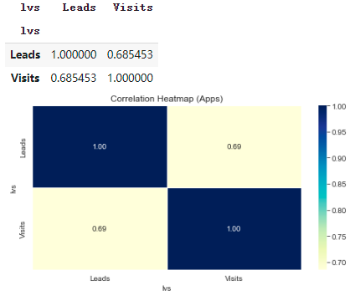
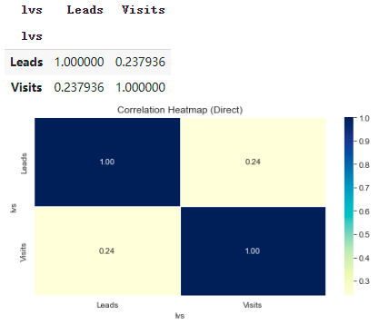
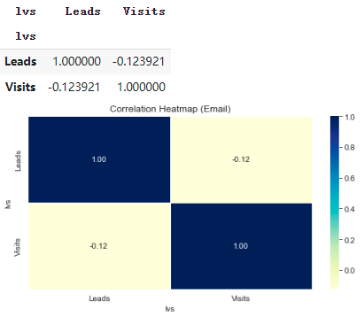

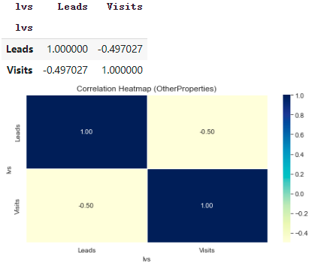
Correlation among spend, leads and visits in Nonpaid
Correlation Coefficients in “NonPaid_Apps”
Correlation Coefficients in “NonPaid_Direct”
Correlation Coefficients in “NonPaid_Email”
Correlation Coefficients in “NonPaid_OtherProperties”
Correlation Coefficients in “NonPaid_SEO”
There is some relationship between Visits and Leads in Nonpaid category.
Notes:
As for Nonpaid category, we find that there are five types of channel data under this category, like “NonPaid_Apps”, “NonPaid_Direct” and “NonPaid_Email”, “NonPaid_OtherProperties”and “NonPaid_SEO”, since notpaid means no spend, in this category let’s only talk about the correlation between leads and visits in each channel.
According to the correlation coefficient matrices, because the correlation coefficients of five channels all fluctuate around 0.5, we can only prove that there is some relationship between Visits and Leads.

Slide 19
Basic Data Trend
revenue
competitor
leads visits spends
macro
inventory

Slide 20
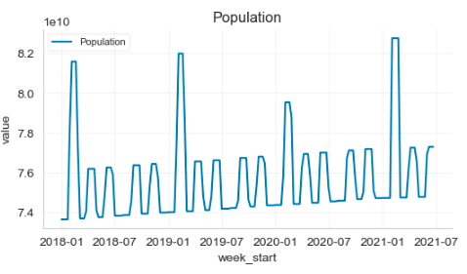
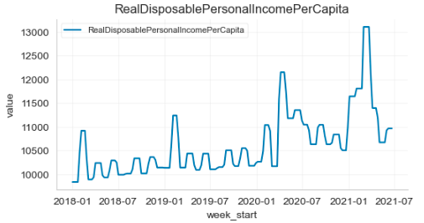
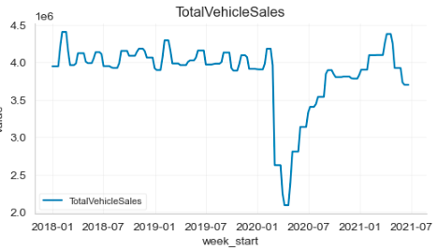
Macro variables
Both Population and Real Disposable Personal Income PerCapita tend to increase in violatility over time and Total Vehicle Sales had a sharp decline in early 2020 and then gradually increased to a normal level.
Notes:
In the dataset, there are three macro variables in total, they are “Macro_Total_Population”,”Macro_Total_RealDisposablePersonalIncomePerCapita” and “Macro_Total_TotalVehicleSales”. And we visualize the data in these three dimensions as follows. According to the graphs, we can see that both Population and Real Disposable Personal Income Per Capita tend to increase in volatility over time and Total Vehicle Sales had a sharp decline in early 2020 and then gradually increased to a normal level. Our preliminary judgment is that this rapid decline may be affected by COVID-19.

Slide 21
Basic Data Trend
revenue
competitor
leads visits spends
macro
inventory

Slide 22
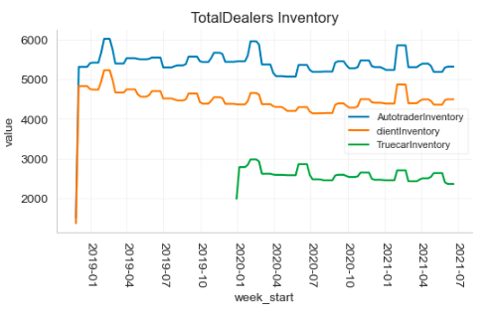
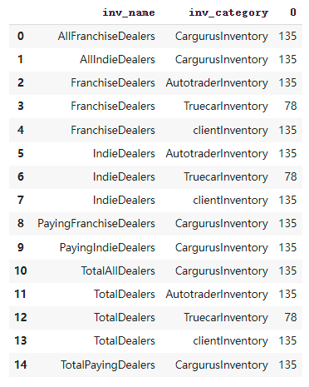
Inventory
Autotraderinvertory, truecarinventory and clientinvertory have the same trend.
Notes:
When we start to process the Inventory data, we find that there are many variables under the Invertory category, so for convenience and more intuitive judgment, we mainly visualized the total dealers inventory like this. And we can find that autotraderinvertory, truecarinventory and clientinvertory have the same trend.

Slide 23
Model feature selection
In this part, the model is mainly consider the impact of several variables representing the channel situation (spends visits leads) on 4 target variables, and we can also add some other variables.
Those 4 targets are:
“Total_DeseasonalizedMarketplace_Revenue",
"Total_Marketplace_SeasonalIndex",
"RevenueByRetail_Marketplace_Revenue
"Total_Total_Visits"

Slide 24
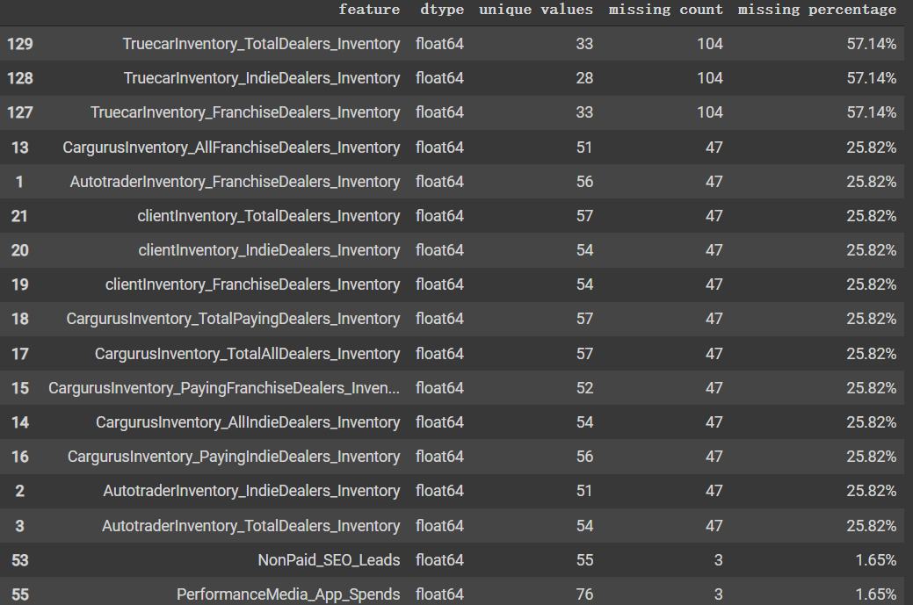
Missing value
There are a lot of missing value in “inventory” feature. We decided to delete those features.
There are very few missing value in other features, so we will use 0 to fill them.

Slide 25
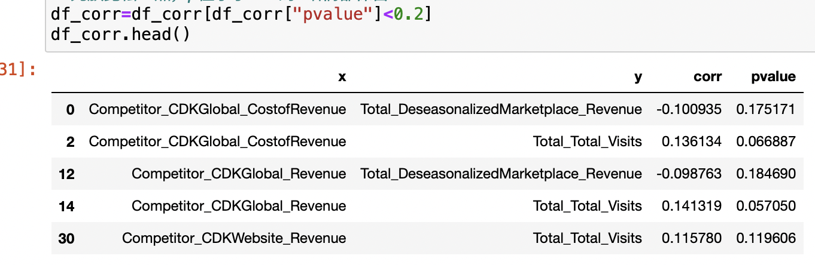
Calculate correlation coefficient between x and y
We decided to calculate the pearson correlation coefficient and pvalue of each features.
We try to keep features which p-value is less than 0.2.

Slide 26
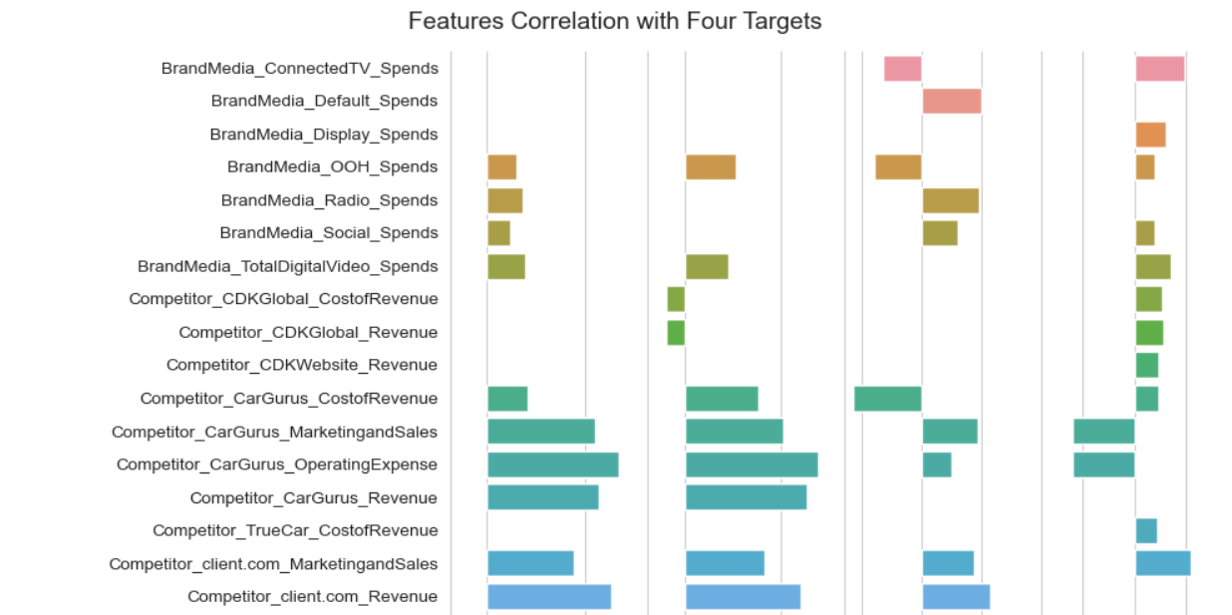
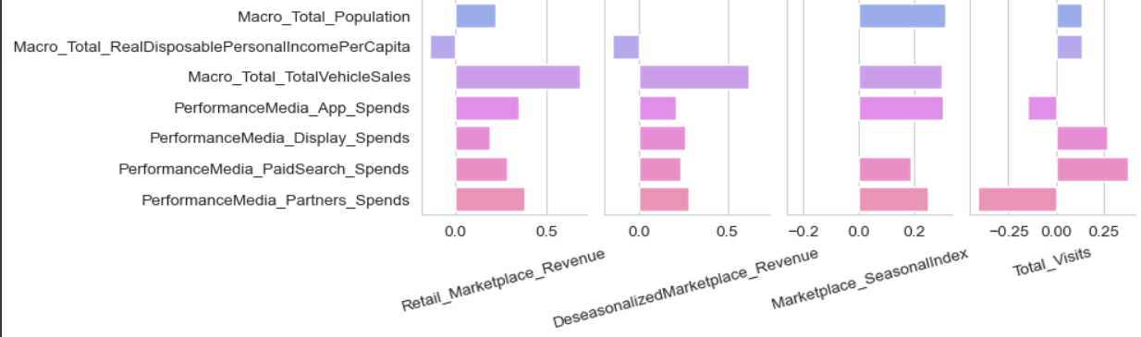

Slide 27
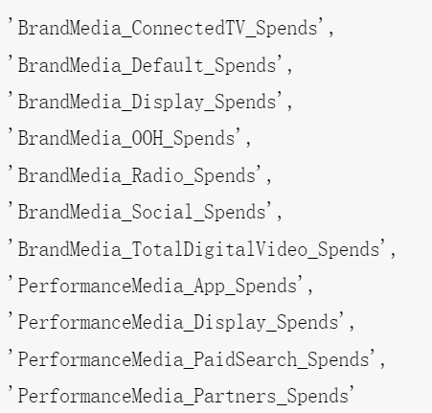
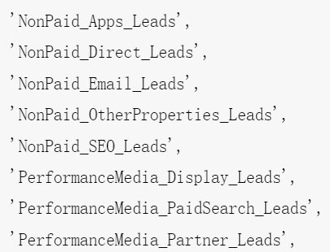
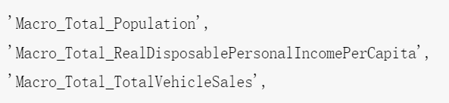
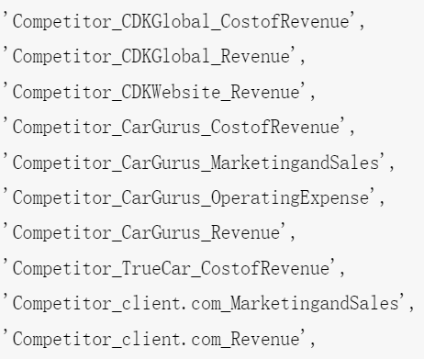
variable reduction and data combining Principal Component Analysis(PCA):
Through the selection of data, we classify the current data features into Spends, Leads, Macro, Competitor:
Macro and Competitor are features that have more correlation with y, although they are not the features we need to focus on, for better performance of the model, we also add them to the model, but in order to avoid the problem of multicollinearity, it is necessary to perform PCA dimensionality reduction on the variables:
Spends:
Leads:
Macro:
Competitor:
The spends and leads are channel-related features, so they need to be put into the model.

Slide 28
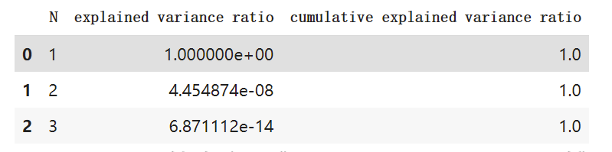
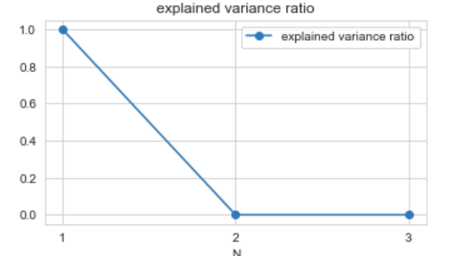
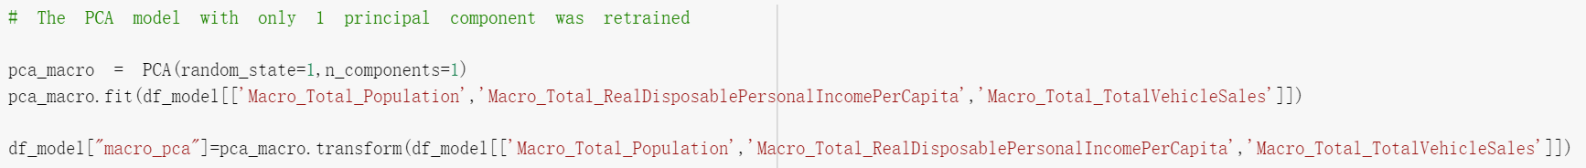
Principal Component Analysis(PCA):
1.PCA dimensionality reduction for Macro:
According to the variance interpretation diagram of the three variables representing Macro, we can see that the variance ratio of the first principal component reaches 1, which explains all the variances in the three variables, so we can reduce the dimensions of the three variables to 1.
Next, we retrain the PCA model with only one principal component as:

Slide 29
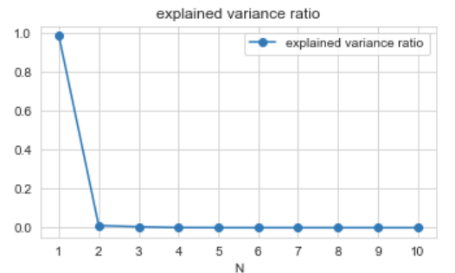
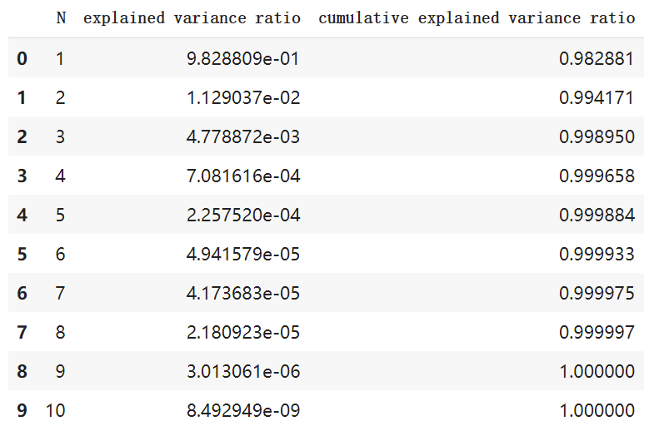
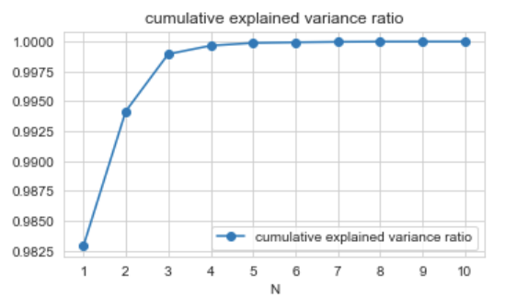
Principal Component Analysis(PCA):
2.PCA dimensionality reduction for Competitor:
Conducting principal component analysis on the 10 competitor variables, we obtained that the variance explained ratio of the first principal component exceeded 98% through the variance explanation plot, so we chose to use the first principal component to replace the rest.

Slide 30
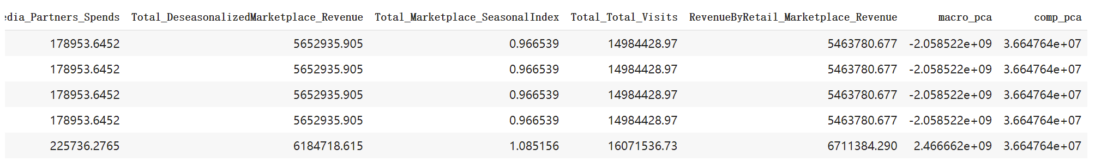
Principal Component Analysis(PCA):
2.PCA dimensionality reduction for Competitor:
Then, we retrain a PCA model with only 1 principal component and get the data below:

Slide 31
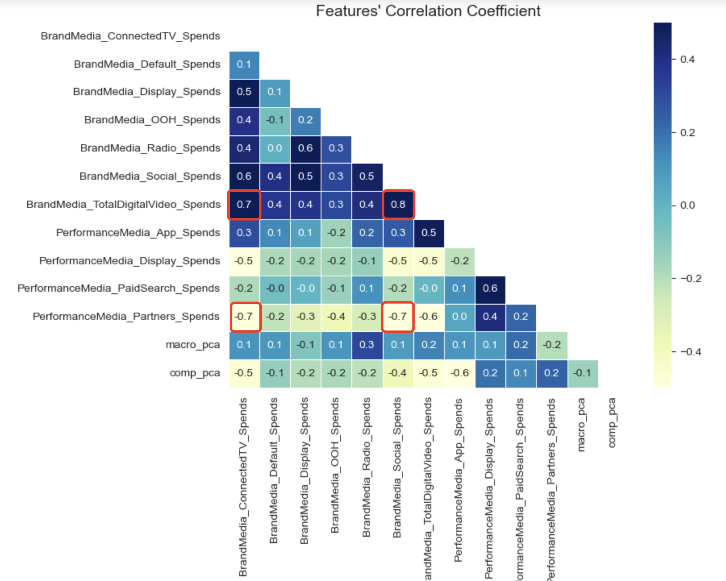

Model (Total_Deseasonalized Marketplace_Revenue)
Goals:
Research on the relationship of 4 targets (DV) between the spends and leads of the channels.
Use linear regression
Since the independent variables (X) are strongly correlated in the real business data, take the Lasso regression, L1 regularization, limiting the effect of the multicollinearity
Step 1: Compute the correlation between these Independent variables (X)
Step 2: Plot the heatmap of the correlation

Slide 32


Step 3: Standardization
Model (Total_Deseasonalized Marketplace_Revenue)
In order to make the coefficients of each feature comparable, we first standardized each feature
Step 4: Regression (DV: Total_Deseasonalized Marketplace_Revenue)
The R squared = 0.6383

Slide 33


Step 5: Scatterplot of actual values and predicted values
Model (Total_Deseasonalized Marketplace_Revenue)
Step 6: coefficient of each feature
Analysis of coefficients(recommendation):
The spends of total six channel have the positive relationship with DeseasonalizedMarketplace_Revenue(DV)
Take PerformanceMedia_Partners_Spends as example，After standardization, every PerformanceMedia_Partners_Spends increases 1 unit，the revenue would increase nearly 750 thousand dollars.
It is not worthwhile to spend a lot on PerformanceMedia_PaidSearch_Spends and some last channel, we suggest to decrease the allocation to these channel in the future.

Slide 34


Model (Total_Total_Visits)
Step 1: Regression (DV: Total_Total_Visits)
The R squared = 0.5597
Step 2: Scatterplot of actual values and predicted values

Slide 35

Model (Total_Total_Visits)
Step 3: coefficient of each feature
Analysis of coefficients(recommendation):
The spends of total six channel have the positive relationship with Total_Visits(DV)
The first three have strong positive affect on It is not worthwhile to spend a lot on the revenue, So it is more efficient to increase these three.
PerformanceMedia_Partners_Spends and some last channel, we suggest to decrease the allocation to these channel in the future.

Slide 36


Model (RevenueByRetail_Marketplace_Revenue)
Step 1: Regression (DV: RevenueByRetail_Marketplace_Revenue)
The R squared = 0.7022
Step 2: Scatterplot of actual values and predicted values

Slide 37

Model (RevenueByRetail_Marketplace_Revenue)
Step 6: coefficient of each feature
Analysis of coefficients(recommendation):
The spends of total nine channel have the positive relationship with DeseasonalizedMarketplace_Revenue(DV)
Take PerformanceMedia_Partners_Spends as example，After standardization, every PerformanceMedia_Partners_Spends increases 1 unit，the revenue would increase more thn 750 thousand dollars.
It is not worthwhile to spend a lot on PerformanceMedia_PaidSearch_Spends and some last channel, we suggest to decrease the allocation to these channel in the future.

Slide 38
Thanks for listening :)
Group 2
Hongyang Zhou
Shuyi Yu
Jiaxun Dong
Zejing Chen
Yunlei Gao
Tongrui Yu

